Slide 1
Differential Privacy in Data Analytics
CS4413 Winter 2026
Afif Saba - 3682801

Slide 2
Why Differential Privacy Matters
Why do we need Differential Privacy?
Key Insight
Organizations want to publish useful statistics
“Anonymous” releases can still leak information
Differential privacy limits single-record influence
“How can we release useful statistics without leaking personal information?”
The Challenge
Why Simple Anonymization Fails
Utility and privacy are naturally in tension
Simple anonymization has repeatedly been shown to fail
Netflix Prize dataset: users re-identified from movie ratings alone
AOL search logs: individuals identified from "anonymous" queries

Slide 3
Differential Privacy Provides a Formal Privacy Guarantee
Definition (ε-Differential Privacy)
The Privacy Parameter ε (Epsilon)
A randomized mechanism 𝑴 satisfies ε-differential privacy if, for any two datasets differing in one individual, the probabilities of any output S remain close.
ε Value
Privacy
Utility
Small
Stronger
Lower
(e.g., 0.1)
^{ε}
Pr[M(D₂) ∈ S]
Balanced
Moderate
Pr[M(D₁) ∈ S] ≤ e
Medium
(e.g., 1.0)
Large
Weaker
Higher
Changing one person’s data only has a limited effect on the output
(e.g., 2.0+)
Smaller ε = stronger privacy, but lower utility.

Slide 4
Project Goal: Comparing Laplace and Gaussian Mechanisms
OUR RESEARCH QUESTION
"Which mechanism, Laplace or Gaussian, provides better utility for common statistical queries under differential privacy?"
TWO MECHANISMS UNDER STUDY
MECHANISM
PRIVACY TYPE
NOISE DISTRIBUTION
Most Relevant For
Laplace
ε-DP
Laplace(0, Δf/ε)
Simple, low-sensitivity aggregate queries
EVALUATION CRITERIA
Gaussian
(ε, δ)-DP
N(0, σ²)
Approximate DP and repeated analysis
Mean absolute error and mean squared error
■
Effect of changing ε on utility
■
Performance by query type: count, mean, histogram
■

Slide 5
Adult Income Dataset and Query Types
Dataset: UCI Adult Income
Three Query Types Tested
QUERY
DESCRIPTION
SENSITIVITY (ΔF)
30,162 cleaned records from the UCI Adult Income dataset
Features used: age, hours-per-week, income, education
Used to evaluate count, mean, and histogram queries
Number of individuals earning >50K
Δf = 1
Count
Average age across all records
Δf = (max − min) / n
Mean
Why Sensitivity Matters
DP noise is calibrated to query sensitivity
Higher sensitivity → more noise
More noise → lower utility
Distribution of education levels
Histogram
Δf = 1

Slide 6
Mechanisms Compared: Laplace vs. Gaussian
Laplace Mechanism
Gaussian Mechanism
Adds noise scaled to query sensitivity.
Adds Gaussian noise calibrated using ε, δ, and sensitivity.
Noise ~ Laplace(0, Δf / ε)
Noise ~ N(0, σ²)
where σ ≥ Δf · √(2 ln(1.25/δ)) / ε
Satisfies pure ε-differential privacy
•
Supports approximate (ε,δ)-DP
•
Worked well for the low-sensitivity queries tested here
•
Common in repeated-analysis and composition settings
•
Simple to implement and analyze
•
Laplace: simple and accurate for low-sensitivity queries | Gaussian: useful for approximate DP and repeated analysis

Slide 7
Implementation and Experimental Setup
Technology Stack
Experiment Setup
Language: Python 3
Mechanisms: Laplace, Gaussian
Queries: Count, Mean, Histogram
ε values: {0.1, 0.5, 1.0, 2.0}
Gaussian setting: δ = 10e-5
Metrics: MAE, MSE
Repeated trials used for averaging
•
•
Libraries: NumPy, pandas
Experimental Design
Repeated trials were run for each query and ε value, and utility was measured using MAE and MSE.
Goal: measure how ε affects utility across mechanisms and query types

Slide 8
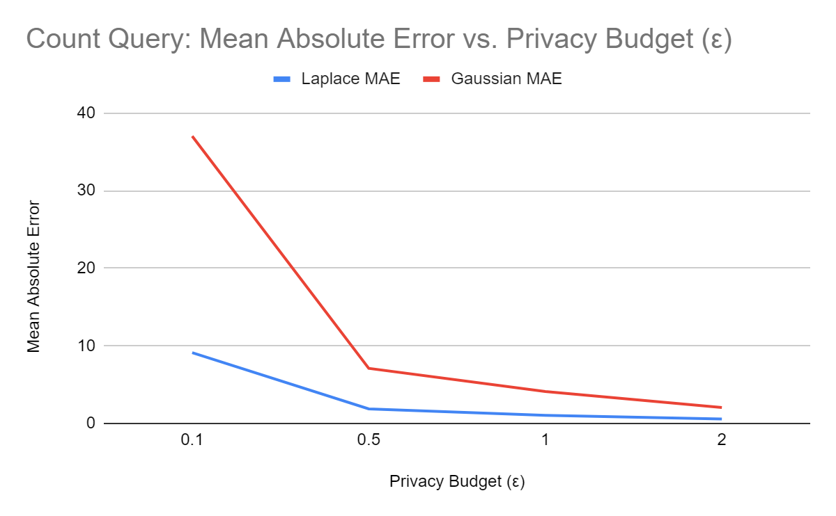
Results: Count Query Utility Improves as ε Increases
Key Observation
Error decreases as ε increases
Laplace has lower error than Gaussian at every tested ε
This confirms the expected privacy–utility trade-off
Examples:
ε = 0.1: Laplace 9.11, Gaussian 37.02
ε = 2.0: Laplace 0.57, Gaussian 2.05

Slide 9
Privacy–Utility Tradeoff: The Core Result
Core Insight
Differential privacy does not remove the tension between privacy and accuracy — it makes the tradeoff measurable and controllable.
PRIVACY GOAL
TYPICAL ε
CONSEQUENCE
≤ 0.1
High noise, limited utility
Strong privacy
Balanced use
≈ 1.0
Acceptable accuracy
Utility-focused
≥ 2.0
Good accuracy, weaker privacy
Strong privacy ⇒ poor accuracy • Weak privacy ⇒ better accuracy
The tradeoff is unavoidable.

Slide 10
Conclusion and Final Takeaways
WHAT WE DEMONSTRATED
CHALLENGES ENCOUNTERED
FUTURE WORK
Differential privacy provides a formal privacy guarantee
Laplace outperformed Gaussian on all tested queries
Higher 𝜀 consistently improved utility
The privacy–utility tradeoff was visible in count, mean, and histogram queries
Choosing appropriate sensitivity bounds
Very small ε values can make outputs much less useful
Gaussian calibration depends on both ε and δ
Test additional query types beyond count, mean, and histogram
Explore alternative Gaussian calibrations and tighter privacy accounting Study repeated-query composition in more detail
Extend the comparison to differentially private machine learning tasks
FINAL TAKEAWAY
Differential privacy is powerful, but it comes at a cost in utility. The key challenge is choosing the right balance between privacy and accuracy.

Slide 11
References
[1] C. Dwork, F. McSherry, K. Nissim, and A. Smith, “Calibrating noise to sensitivity in private data analysis,” in Theory of Cryptography (TCC 2006), 2006, pp. 265–284.
[2] K. Nissim, S. Raskhodnikova, and A. Smith, “Smooth sensitivity and sampling in private data analysis,” in Proceedings of the ACM Symposium on Theory of Computing, 2007, pp. 75–84.
[3] B. Balle and Y.-X. Wang, “Improving the Gaussian mechanism for differential privacy: Analytical calibration and optimal denoising,” in Proceedings of the 35th International Conference on Machine Learning, 2018.
[4] I. Mironov, “Rényi differential privacy,” in Proceedings of the IEEE 30th Computer Security Foundations Symposium, 2017, pp. 263–275.
[5] J. Near, D. Darais, N. Lefkovitz, and G. Howarth, Guidelines for Evaluating Differential Privacy Guarantees, NIST Special Publication 800-226, 2025.
[6] OpenDP, “A framework to understand DP,” OpenDP Documentation.
[7] Google, “Google’s differential privacy libraries,” GitHub repository.
[8] S. Haney, D. Desfontaines, L. Hartman, R. Shrestha, and M. Hay, “Precision-based attacks and interval refining: how to break, then fix, differential privacy on finite computers,” arXiv:2207.13793, 2022.
[9] UCI Machine Learning Repository, “Adult Data Set.”

Slide 12
Thank You
Any Questions?

